Slide 1

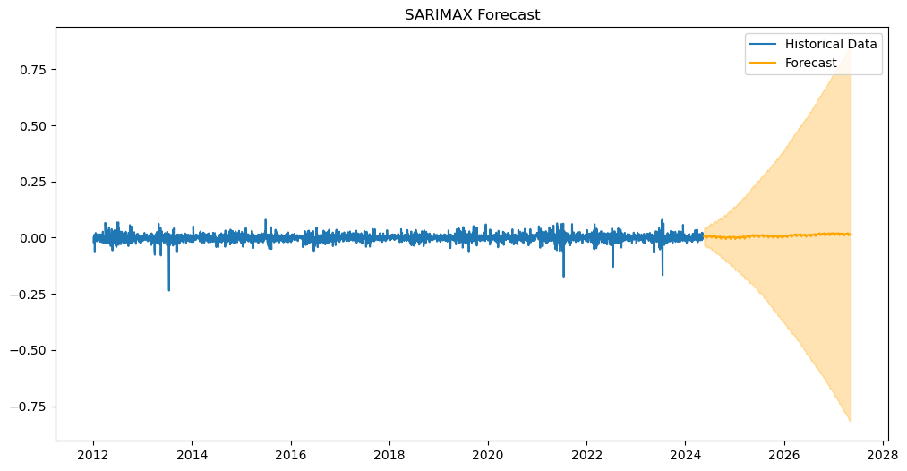
"Evaluating the Impact of Weather Conditions on Agricultural Stock Market Performance Using Time Series Forecasting""
Rosemary Dejesus Ramirez Cords
Higher Diploma in Science in Data Analytics for Business
INTRODUCTION
RESULTS
Agriculture is highly sensitive to climate change, with extreme weather events, disrupting seasonal patterns and destabilizing production. These disruptions not only affect grain supply but also drive price volatility.
This extends this understanding by examining the broader economic consequences of weather events, particularly their influence on financial markets, through how it affect the performance of stock market, and analysing the relationship between them.
By integrating insights from agriculture and financial markets, this research aims to advance decision-making forescat and predictions, providing actionable intelligence to investors and risk managers.
OBJECTIVES
The 3 points below represent the core focus of the entire study:
Examine the Impact of Weather Events on Stock Market Performance, analysing how some specific weather conditions influence in stock market returns over time.
Analyse the causal relationships between time series data points and external factors to identify key drivers of changes in the data, such as weather factors.
Test and compare different machine algorithm models to assess their accuracy in forecasting or capturing the underlying structure of the data.
METHODOLOGY AND MATERIALS
The methodology involves collecting and preprocessing historical data on weather and stock market, ensuring clean and normalized datasets aligned over time. Exploratory Data Analysis (EDA) is conducted to uncover patterns and relationships between weather events and stock market performance. We then apply various modelling approaches: ARIMA and SARIMA to capture time-series trends and seasonality, while Linear Regression and Random Forest Regressor captures actual and predicted values. Models are evaluated using metrics like MAE, RMSE, and R-squared, with cross-validation and hyperparameter tuning enhancing performance. Finally, a forescat is performed to understand and predict the economic impacts of extreme weather.
REFERENCES

